Slide 1


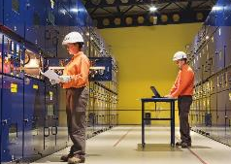

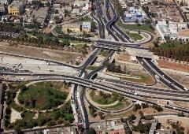
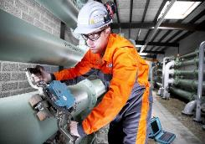
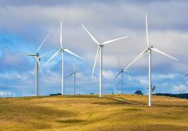
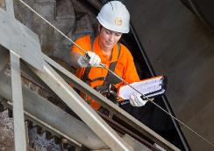

ENERGY & INDUSTRY
DIVISION

Slide 2
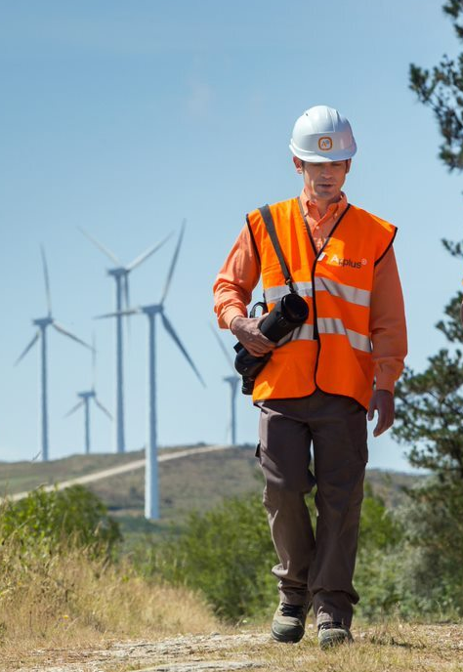
Index
Applus+ Group |  |  |  |  | 3
About Us |  |  |  |  | 4
Global Presence |  |  |  |  | 5
Markets |  |  |  |  | 6
 | Infrastructure & Buildings |  |  |  | 8
 | Renewable Energy |  |  |  | 9
 | Power |  |  |  | 10
 | Oil & Gas |  |  |  | 11
 | Other Industries |  |  |  | 12
Our Brands |  |  |  |  | 14

Slide 3




Applus+ Group | About Us | Global Presence | Markets | Our Brands
Applus+ Group
Applus+ is a worldwide leader in the testing, inspection and certification sector.
We are a trusted partner, enhancing the quality and safety of our clients’ assets and infrastructures, while improving their operations and safeguarding their environmental performance. Our innovative approach, technical capabilities and highly-skilled workforce of over 25,000 employees assure operational excellence across multiple sectors in more than 65 countries.
The Group is organised in four divisions: Energy & Industry, IDIADA, Laboratories and Automotive, and is rated as sustainable organisation by Standard Ethics Rating (EE+).
We offer a complete portfolio of solutions that address a range of needs, from asset integrity management to statutory compliance-based inspections.
25,000+
people in 2022
65+
countries across all continents
€2,049m
total revenue in 2022
accredited
by major international organisations

Slide 4







Applus+ Group | About Us | Global Presence | Markets | Our Brands
About Us: Energy & Industry Division
16,000+
people in 2022
€1,120.7M
total revenue in 2022
60+
countries across all continents
Services
Global Presence
We deliver inspection, testing, supervision & QA/QC services, as well as engineering and technical consulting for a wide range of markets, including renewables, infrastructure, conventional power, oil and gas, and many other industries.
We are present in more than 60 countries in all continents with more than 15,000 highly qualified employees.
We provide a complete range of integrated services across our global operation.
Technology & Digitalization
Objectives
We offer a range of automated inspection and reporting techniques designed to provide timely and accurate data, and to reduce the risks inherent in conventional data acquisition and interpretation.
We help our clients to improve their performance, increase the profitability of their facilities and minimize their operational risks, by ensuring the quality of their processes and complying with environmental standards and regulations.

Slide 5
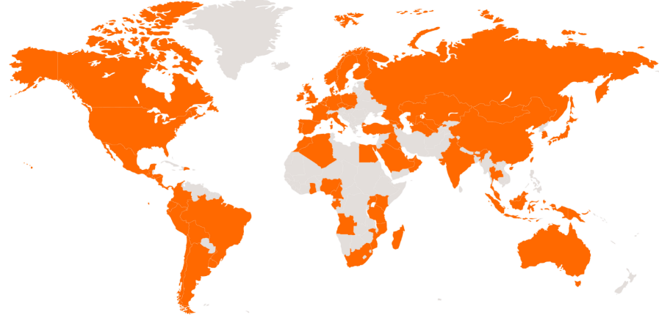
Applus+ Group | About Us | Global Presence | Markets | Our brands
Global presence: Energy & Industry Division
Payroll distribution and revenue (December 2022)
Northern Europe
People: 1,228
Revenue(M€): 15%
United States
and Canada
Mediterranean
Pacific Asia
People: 1,417
Revenue (M€): 20%
People: 4,096
Revenue(M€): 21%
People: 727
Revenue(M€): 22%
Latin America
Middle East and Africa
People: 5,157
Revenue(M€): 14%
People: 3,431
Revenue(M€): 12%
Angola Argentina Algeria Australia Belgium Bolivia Brazil | Brunei Canada Chile China Colombia Costa Rica Czech Republic | Denmark Dominican Republic Ecuador Egypt El Salvador Finland France | Georgia Germany Guatemala Honduras India Indonesia Ireland | Italy Japan Kazakhstan Kuwait Malaysia Morocco Mexico | Mozambique The Netherlands Nicaragua Nigeria Norway Oman Panama | Papua New Guinea Peru Poland Portugal Qatar Russia Saudi Arabia | Singapore Slovakia South Africa South Korea Spain Turkey Turkmenistan | UAE United Kingdom Uruguay USA Uzbekistan

Slide 6








Applus+ Group | About Us | Global Presence | Markets | Our Brands
Markets & Portfolio
Markets
Infrastructure and Buildings
Power
Renewable Energy
Industry
Telecommunications
Government and Public Organisations
Marine
Oil & Gas
Services
Key Themes
Engineering and Consulting
Inspection
Non Destructive Testing
Supervision and QA/QC
Technical Staffing
Testing and Analysis
Vendor Surveillance
Certification
3D Laser Scanning
Advanced NDT
Asset Integrity Management
UAV (Drone) Inspection
Energy Efficiency
Environment
Geo-hazard Assessment
Health and Safety
Materials testing
Offshore Inspection
Pipeline New Construction
Pipeline integrity
Verification of Conformity (VoC)

Slide 7

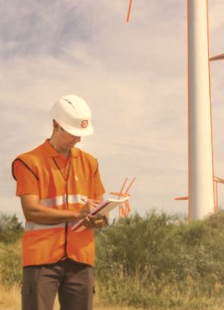



Applus+ Group | About Us | Global Presence | Markets | Our Brands
Solutions covering all project phases
We help our clients to manage risks, improve safety and operational performance, while increasing efficiency and reliability.
Present throughout the asset lifecycle
Pre-Construction
Construction
Operation
Commissioning, Maintenance and Asset Life Extension
Vendor surveillance
Specialized consulting
Non-destructive testing
Inspection & Monitoring
Material testing
Non-destructive testing
Risk based inspection
Fitness for service
QA/QC services
Failure analysis
Specialized consulting

Slide 8


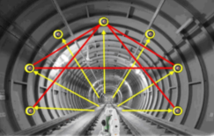
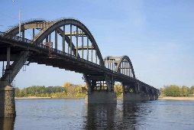


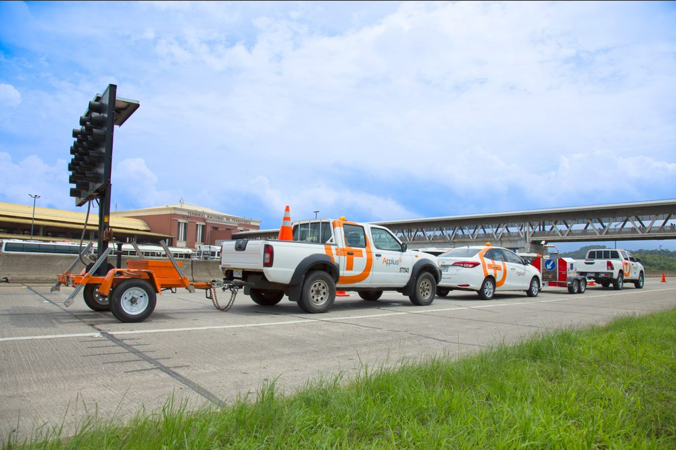

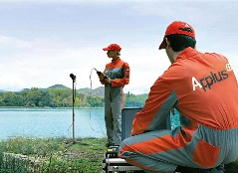






Applus+ Group | About Us | Global Presence | Markets | Our Brands
Infrastructure and Buildings
Applus+ provides infrastructure project-related assurance, consulting, testing and inspection services on private and public works, in all areas of civil and construction engineering.
We provide services for every phase of our clients’projects: design, construction, operation and maintenance.
Main Services
Engineering and Technical Consulting | Supervision and QA/QC | Instrumentation / Monitoring | Asset Integrity management | Geotechnical and Material Testing
Health and Safety Evaluation | Road Management | Energy Efficiency | Water pipeline Inspection and Rehabilitation | Technical Staffing
Markets
Civil
Infrastructure
Buildings
Mining
Industrial
Construction
Water

Slide 9





Applus+ Group | About Us | Global Presence | Markets | Our Brands
Renewable Energy
Applus+ delivers services and solutions to our clients in all continents.
Main Services
Appraisal & Feasibility
Preconstruction and Financing
Construction Management
Commissioning
Operation
IPP Tender Support | Technical Due Diligence | Owner’s Engineering |  | Commissioning Supervision & Management | Technical Due Diligence (M&A)
Pre-feasibility Analysis | Preliminary Technical Studies: EIA, connection studies, topography, etc. | Detailed Design |  |  | Independent Audits
Red-Flag Analysis | Support on main contracts equipment, EPC/O&M | Supervision of Manufacturing and Quality Testing |  |  | Inspections: civil, mechanical, electrical, environmental and HSE
Basic Engineering | Technical Specifications Review | Support in FAT |  |  | Electrical testing / Predictive maintenance
Resource and Energy production studies
Financial model review |  | Construction management
CAPEX and OPEX estimation |  | Inspection and Testing
 |  | Environmental Inspection and Control
Technical Staffing
Health & Safety Evaluation – HSE
Markets
Wind onshore
& offshore
Solar PV & CSP
Storage
Hydrogen
Hydraulic

Slide 10


Applus+ Group | About Us | Global Presence | Markets | Our Brands
Power
Applus+ provides testing, inspection and certification (TIC) services to the power market during generation, transmission and distribution of energy.
Main Services
Feasibility
Project Design and Development
Construction, Assembling & Commissioning
Operation & Maintenance
Basic and Detailed Engineering
Technical Staffing/ Project Management
Studies
Substations Engineering
Supervision and TA for
Construction and Assembly
(aerial and underground lines,
and substations)
Predictive and Corrective
Maintenance
Technical Consulting
High Voltage Lines Engineering
(up to 400 kV)
Statutory Inspections
Simulations
Network Engineering MV/LV
Aerial Inspections and
Digitalization
Energy Systems Analysis
Procedures and Expropriations
Management
Vendor Surveillance
Feasibility Studies
Tenders and Support for
Service Contracting
Quality Assurance / Quality Control / Testing
Basic Design
Network Normalization
Commissioning
Inspection of Equipment
Markets
Electrical Networks
Nuclear
Conventional Generation

Slide 11

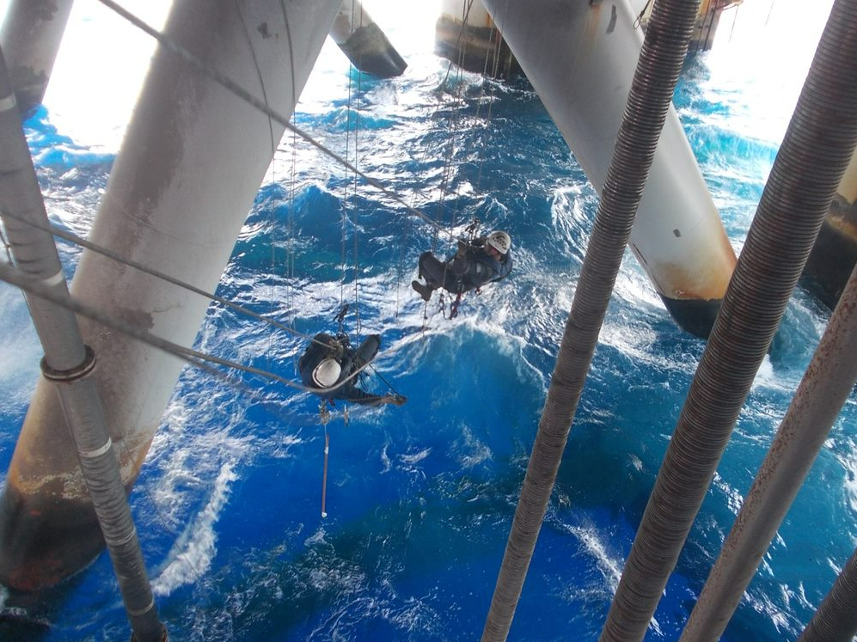

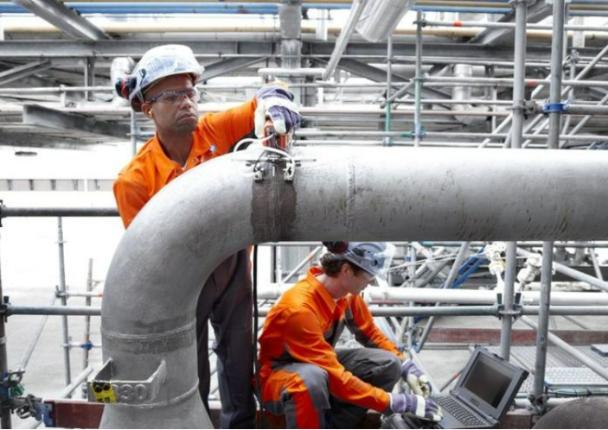
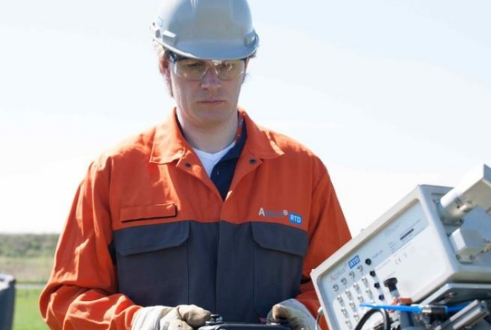
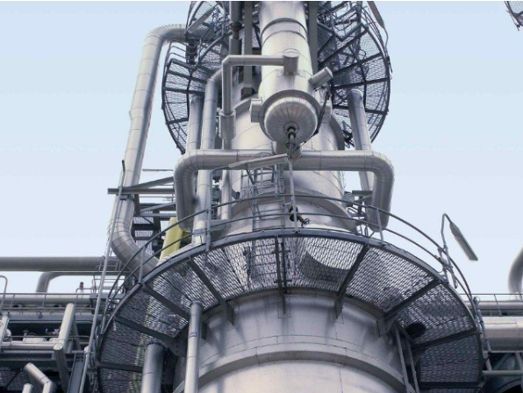
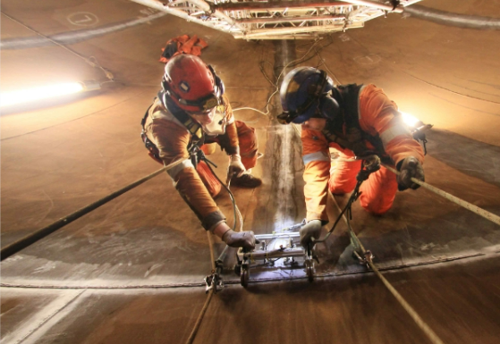

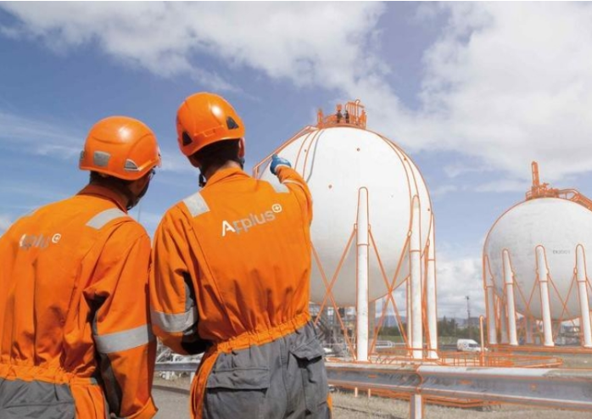


Applus+ Group | About Us | Global Presence | Markets | Our Brands
Oil & Gas
We offer inspection, non-destructive testing (NDT), certification and technical assistance solutions to assure quality, safety and reliability of our clients’ facilities throughout the project phases (feasibility, construction, commissioning, operation and maintenance).
Main Services
Rig Inspection, Audits and Rig Commissioning | New Construction Consulting and Inspection | Risk Based Evaluation | UT Advanced Testing
Plant Lifecycle Management | Rope Access NDT and Inspection | Vendor Surveillance | Asset Integrity Management
Markets
Upstream
Midstream
Downstream

Slide 12
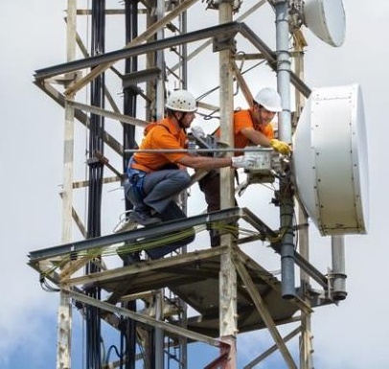
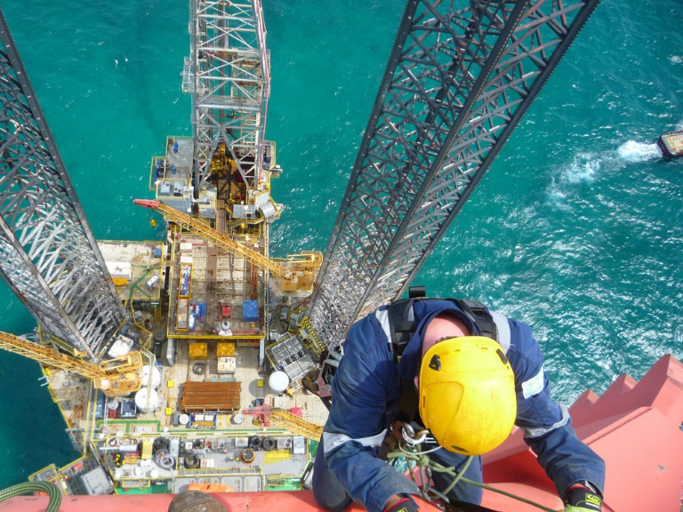


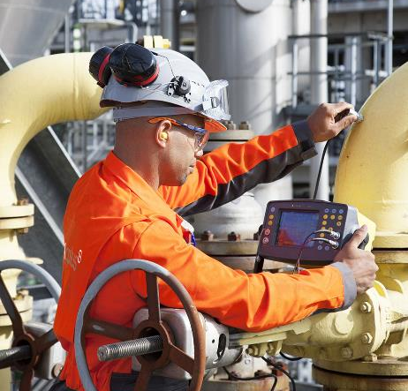
Applus+ Group | About Us | Global Presence | Markets | Our Brands
Telecommunications
Marine
We provide services for operators, telecommunications infrastructure managers, equipment manufacturers, large engineering companies, private corporations and public bodies in the deployment, operation and maintenance of fixed and mobile telecommunications networks.
We provide a diverse range of marine non-destructive testing (NDT) and maritime certification services, as well as technical training and process outsourcing for vessels, rigs, marine and harbour applications. In addition, we carry out the product and service evaluation within the maritime and offshore inspection industry.
Gorvernment and Public Organisations
Industry
We deliver energy efficiency surveys, environmental management, process optimisation, supervision and maintenance services for public infrastructure and assets.
We assure the integrity of our clients’ assets by complying with regulatory and quality standards, from international engineering codes to local health and safety, and environmental
requirements.

Slide 13
Applus+ Group | About Us | Global Presence | Markets | Our Brands
Technology and Digitalisation
The Energy & Industry Division consider technology and digital tools as key drivers to provide best-in-class services to our clients.
Applus+ dedicates a wide range of resources, as well as its global presence, reputation and business knowledge to develop, consolidate and deliver the most advanced technological and digital solutions in the market with the highest standards.
Research, Development & Innovation
for internal devolpment of inspection tools
Corporate Venturing
reaching the best start-ups for strategic alliances
Privileged access
to the best technology providers
Business Teams
Infrastructure and Buildings, Renewables, Power, Oil & Gas, Other Industries
Better quality, better experience, higher speed, same confidence

Slide 14
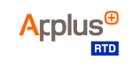



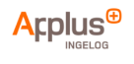
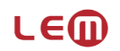





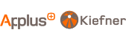


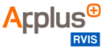
Applus+ Group | About Us | Global Presence | Markets | Our Brands
Our Brands
Energy & Industry Division integrates multiple brands as a result of our acquisition strategy that have strengthened the Division and the Group throughout their history.
Notes:
AGREGAR LOGO APPLUS

